Slide 1
Sensors and Maps
COMP3097 Mobile Web Development
Week 11

Slide 2
This week
Sensors
GPS
Maps

Slide 3
Introduction
Sensors and Geolocation services are strongly dependent on the hardware and software (OS) of the device.
There can’t be any assumptions in this area as they lead to runtime issues and crushes
In addition, some plugins are platform specific (e.g., they work only on Android or iOS)

Slide 4
Sensors
https://ionicframework.com/docs/native/sensors

Slide 5
Sensors API
The sensors are capable of providing raw data with high precision and accuracy, and are useful if you want to monitor three-dimensional device movement or positioning, or you want to monitor changes in the ambient environment near a device.
For example, a game might track readings from a device's gravity sensor to infer complex user gestures and motions, such as tilt, shake, rotation, or swing. Likewise, a weather application might use a device's temperature sensor and humidity sensor to calculate and report the dewpoint, or a travel application might use the geomagnetic field sensor and accelerometer to report a compass bearing.
At this moment this plugin is implemented only for Android!

Slide 6
Basic methods
sensors.enableSensor("TYPE_SENSOR") – Enable sensor.
sensors.disableSensor() – Disable sensor.
sensors.getState(successCallback, errorCallback) – Get values sensor

Slide 7
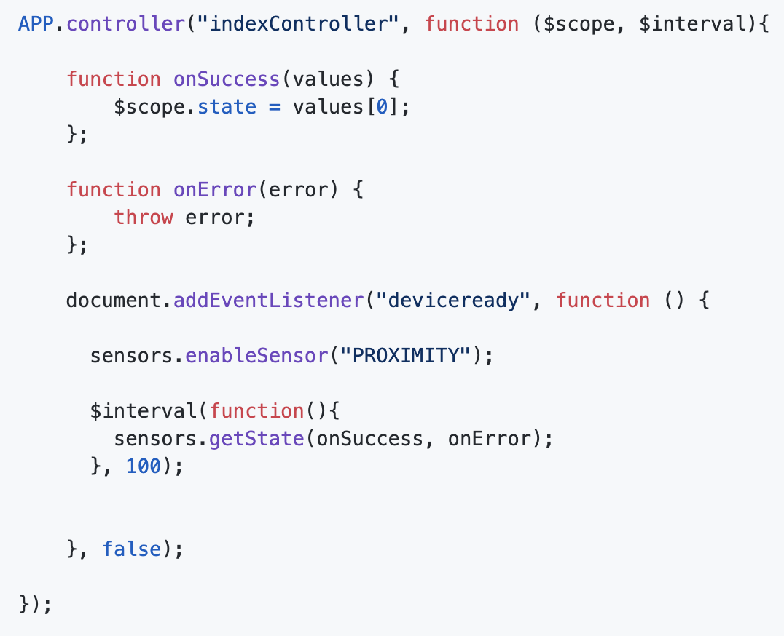
Usage

Slide 8
Sensor types
PROXIMITY - Measures the proximity of an object in cm relative to the view screen of a device.
ACCELEROMETER - Measures the acceleration force in m/s2 that is applied to a device on all three physical axes (x, y, and z), including the force of gravity.
GRAVITY - Measures the force of gravity in m/s2 that is applied to a device on all three physical axes (x, y, z).
GYROSCOPE - Measures a device's rate of rotation in rad/s around each of the three physical axes (x, y, and z).
GYROSCOPE_UNCALIBRATED - Rate of rotation (without drift compensation) around the x axis.

Slide 9
Sensor types
LINEAR_ACCELERATION - Measures the acceleration force in m/s2 that is applied to a device on all three physical axes (x, y, and z), excluding the force of gravity.
ROTATION_VECTOR - Measures the orientation of a device by providing the three elements of the device's rotation vector.
STEP_COUNTER - Number of steps taken by the user since the last reboot while the sensor was activated.
GAME_ROTATION_VECTOR - Rotation vector component along the x axis (x * sin(θ/2)).
GEOMAGNETIC_ROTATION_VECTOR - Rotation vector component along the x axis (x * sin(θ/2)).

Slide 10
Sensor types
MAGNETIC_FIELD - Measures the ambient geomagnetic field for all three physical axes (x, y, z) in μT.
MAGNETIC_FIELD_UNCALIBRATED - Geomagnetic field strength (without hard iron calibration) along the x axis.
ORIENTATION - Measures degrees of rotation that a device makes around all three physical axes (x, y, z).
AMBIENT_TEMPERATURE - Measures the ambient room temperature in degrees Celsius (°C). See note below.

Slide 11
Sensor types
LIGHT - Measures the ambient light level (illumination) in lx.
PRESSURE - Measures the ambient air pressure in hPa or mbar.
RELATIVE_HUMIDITY - Measures the relative ambient humidity in percent (%).
TEMPERATURE - Measures the temperature of the device in degrees Celsius (°C).

Slide 12
Geolocation
https://ionicframework.com/docs/native/geolocation

Slide 13
Introduction
This plugin provides information about the device's location, such as latitude and longitude. Common sources of location information include Global Positioning System (GPS) and location inferred from network signals such as IP address, RFID, WiFi and Bluetooth MAC addresses, and GSM/CDMA cell IDs.
This API is based on the W3C Geolocation API Specification, and only executes on devices that don't already provide an implementation.

Slide 14
Additional config for iOS
For iOS you have to add this configuration to your configuration.xml file
<edit-config file="*-Info.plist" mode="merge" target="NSLocationWhenInUseUsageDescription">
<string>We use your location for full functionality
of certain app features.</string>
</edit-config>

Slide 15
Introduction
This plugin provides information about the device's location, such as latitude and longitude.
Common sources of location information include Global Positioning System (GPS) and location inferred from network signals such as IP address, RFID, WiFi and Bluetooth MAC addresses, and GSM/CDMA cell IDs. There is no guarantee that the API returns the device's actual location.

Slide 16
Introduction
Collection and use of geolocation data raises important privacy issues. Your app's privacy policy should discuss how the app uses geolocation data, whether it is shared with any other parties, and the level of precision of the data (for example, coarse, fine, ZIP code level, etc.).
Geolocation data is generally considered sensitive because it can reveal user's whereabouts and, if stored, the history of their travels.
Therefore, in addition to the app's privacy policy, you should strongly consider providing a just-in-time notice before the app accesses geolocation data (if the device operating system doesn't do so already).

Slide 17
Methods
navigator.geolocation.getCurrentPosition – getting last known location
navigator.geolocation.watchPosition – starting a location observer
navigator.geolocation.clearWatch – stopping the location observer

Slide 18
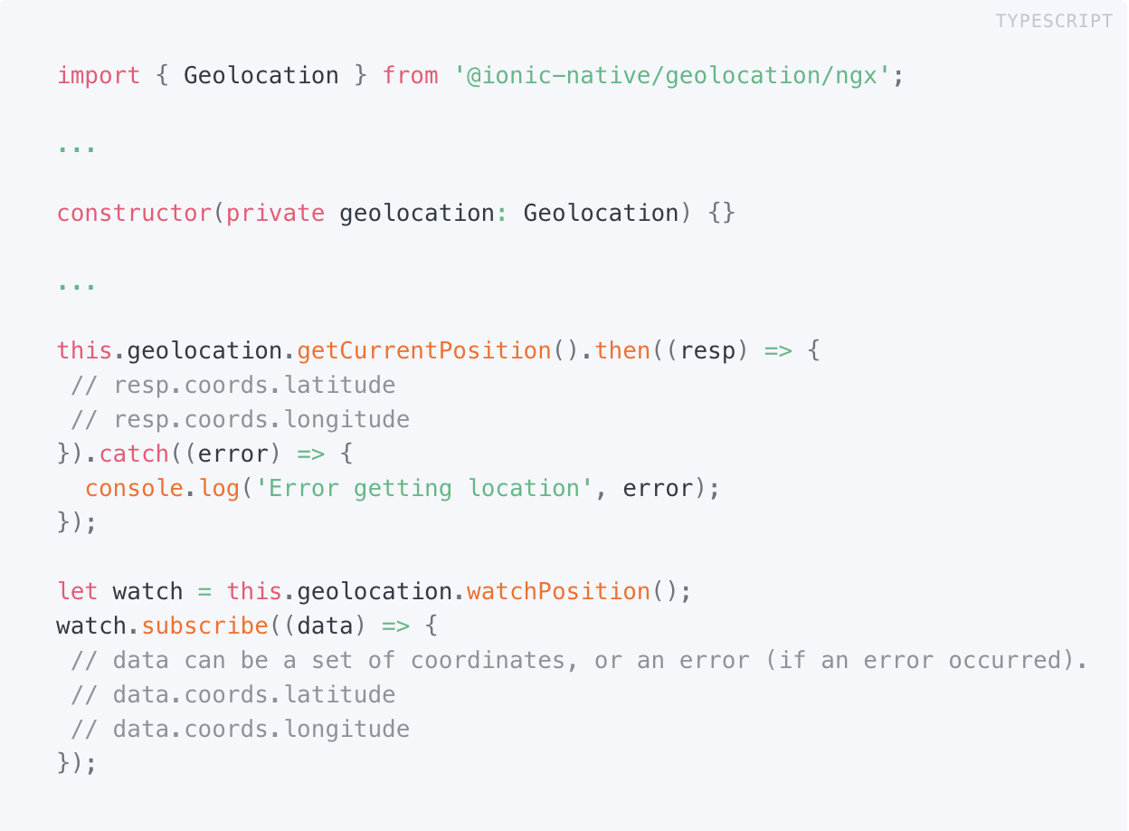
Usage

Slide 19
Details
https://github.com/apache/cordova-plugin-geolocation

Slide 20
Maps
https://github.com/ionic-team/ionic-native-google-maps

Slide 21
Introduction
Ionic Native wraps plugin callbacks in a Promise or Observable, providing a common interface for all plugins and making it easy to use plugins with Angular change detection.
Before you use it, make sure that you generate the Google Maps keys for each platform where maps will be used
Good presentation about Maps: https://docs.google.com/presentation/d/e/2PACX-1vScoho1ensbR4qCI9AIuQN55BZVvK73pAjI7sumDvW3CrxxHnrmpXWUjx2-8CpFibqU1EjLKCRhuthJ/pub?start=false&loop=false&delayms=3000

